Slide 1

SQL Data Warehouse & Analytics Project

Slide 2




SQL Project
Data Warehouse
Exploratory Data Analysis (EDA)
Advanced Data Analytics
Organize, Structure, Prepare
ETL/ELT Processing
Data Architecture
Data Integration
Data Cleaning
Data Load
Data Modeling
Stored Procedures
Understand Data
Basic Queries
Data Profiting
Simple Aggregation
Subquery
Views
Answer Business Questions
Complex Queries
Windows Functions
CTE
Subqueries
Reports

Slide 3
ETL Methods
Truncate & Insert
Pull Extraction
Push Extraction
Batch Processing
Stream Processing
Upsert
ETL
Full Load
Drop, create, insert
Full Extraction
Extraction Methods
Processing Types
Extraction Types
Load Methods
Incremental Extraction
Upsert
Extraction
Load
Incremental Load
Append
Database Querying
Merge
Manual Data Extraction
Transformation
Extraction Techniques
Slowly Changing Dimensions (SCD)
No Historization
File Parsing
Overwrite
API Calls
Historization
Event Based Streaming
SCD
CDC
Data Enrichment
Data Normalization & Standardization
Data Integration
Business rules & Logic
Web Scraping
Derived Columns
Data Aggregations
Data Cleaning
Remove Duplicates
Data Filtering
Handling Missing Data
Handling Invalid Values
Handling Unwanted Spaces
Data Type Casting
Data Type Casting

Slide 4



Data Warehouse
Inmon
Stage
EDW
Data Marts
Data Lake
Kimball
Stage
Data Marts
Data Architectures
Data Lakehouse
Data Vault
Stage
EDW
Data Marts
Business Vault
Medallion Architecture
Bronze
Silver
Gold
Data Mesh

Slide 5
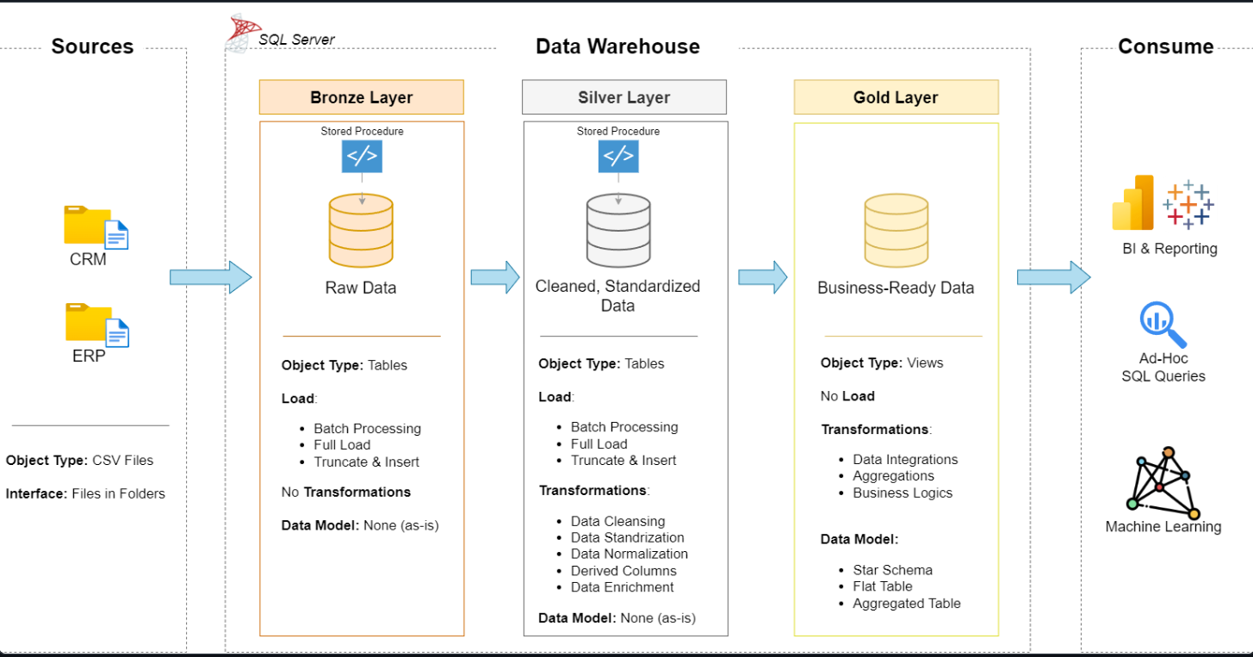

Slide 6
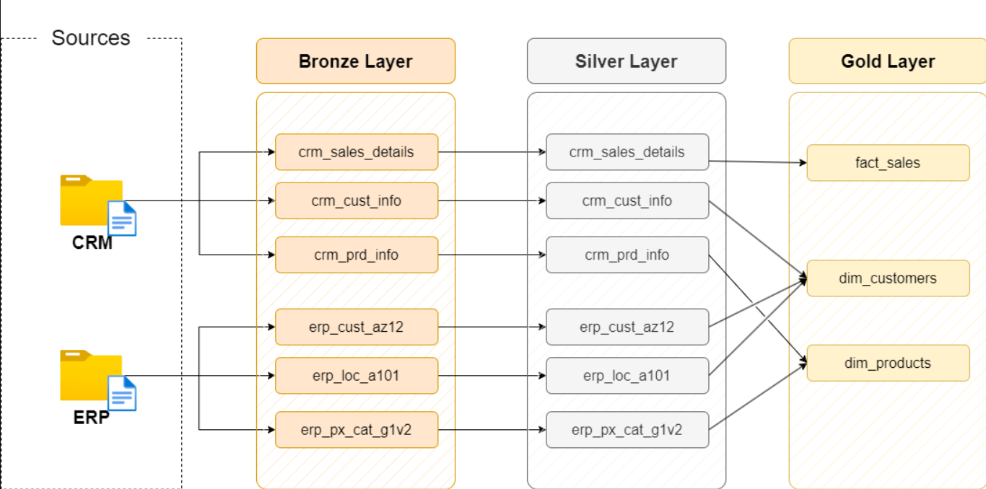
Data Flow (LINKAGE)

Slide 7
Bronze Layer
Silver Layer
Gold Layer
Definition
Raw, unprocessed data as-is from sources
Clean & Standardized Data
Business-Ready data
Objective
Traceability & Debugging
(Intermediate Layer)
Prepare Data for Analysis
Provide data to be consumed for reporting & Analytics
Object Type
Tables
Tables
Views
Load Method
Full Load
(Truncate & Insert)
Full Load
(Truncate & Insert)
None
Data Transformation
None (as-is)
Data Cleaning
Data Standardization
Data Normalization
Derived Columns
Data Enrichment
Data Integration
Data Aggregation
Business Logic & Rules
Data Modeling
None (as-is)
None (as-is)
Start Schema
Aggregation Objects
Flat Tables
Target Audience
Data Engineers
Data Analysts
Data Engineers
Data Analysts
Business Users

Slide 8
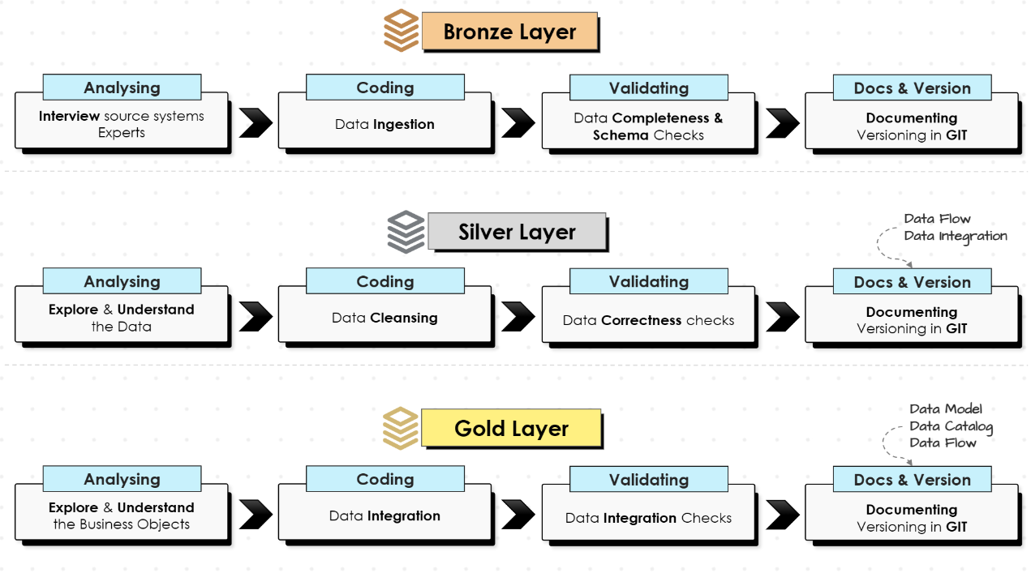

Slide 9
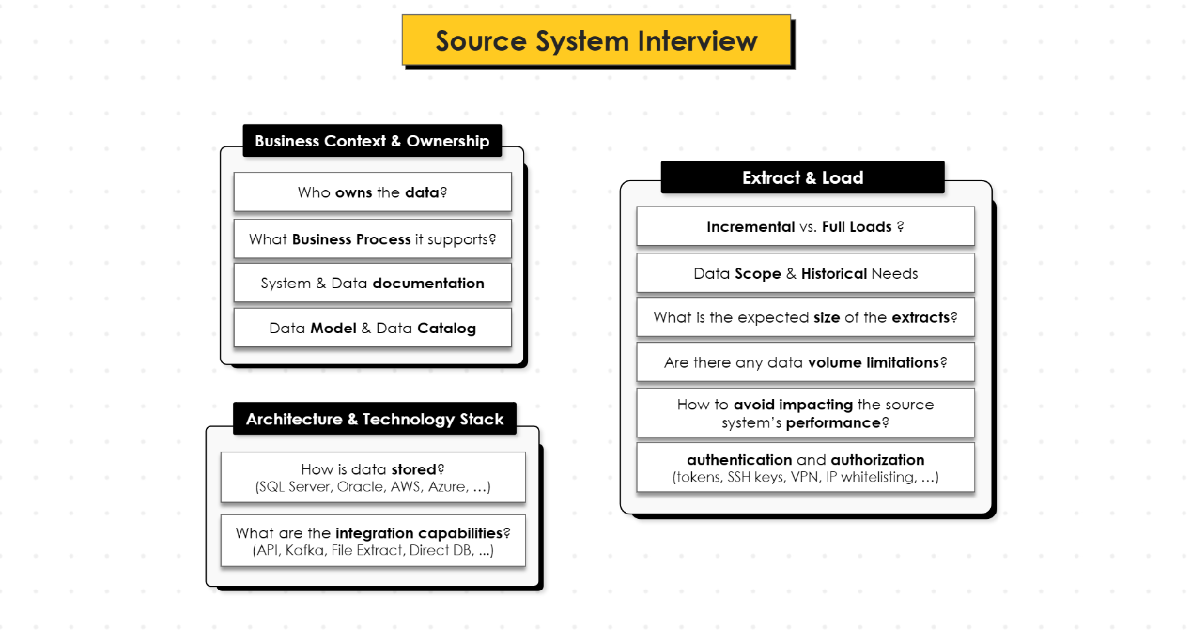

Slide 10








1 Day
1 Day
1 Day
Fast Hours & Automation
Integrated & History
Data Warehouse
Transform
Transform
Transform
ETL
Collect
Collect
Collect
Big Data
Standard
Data Warehouse

Slide 11
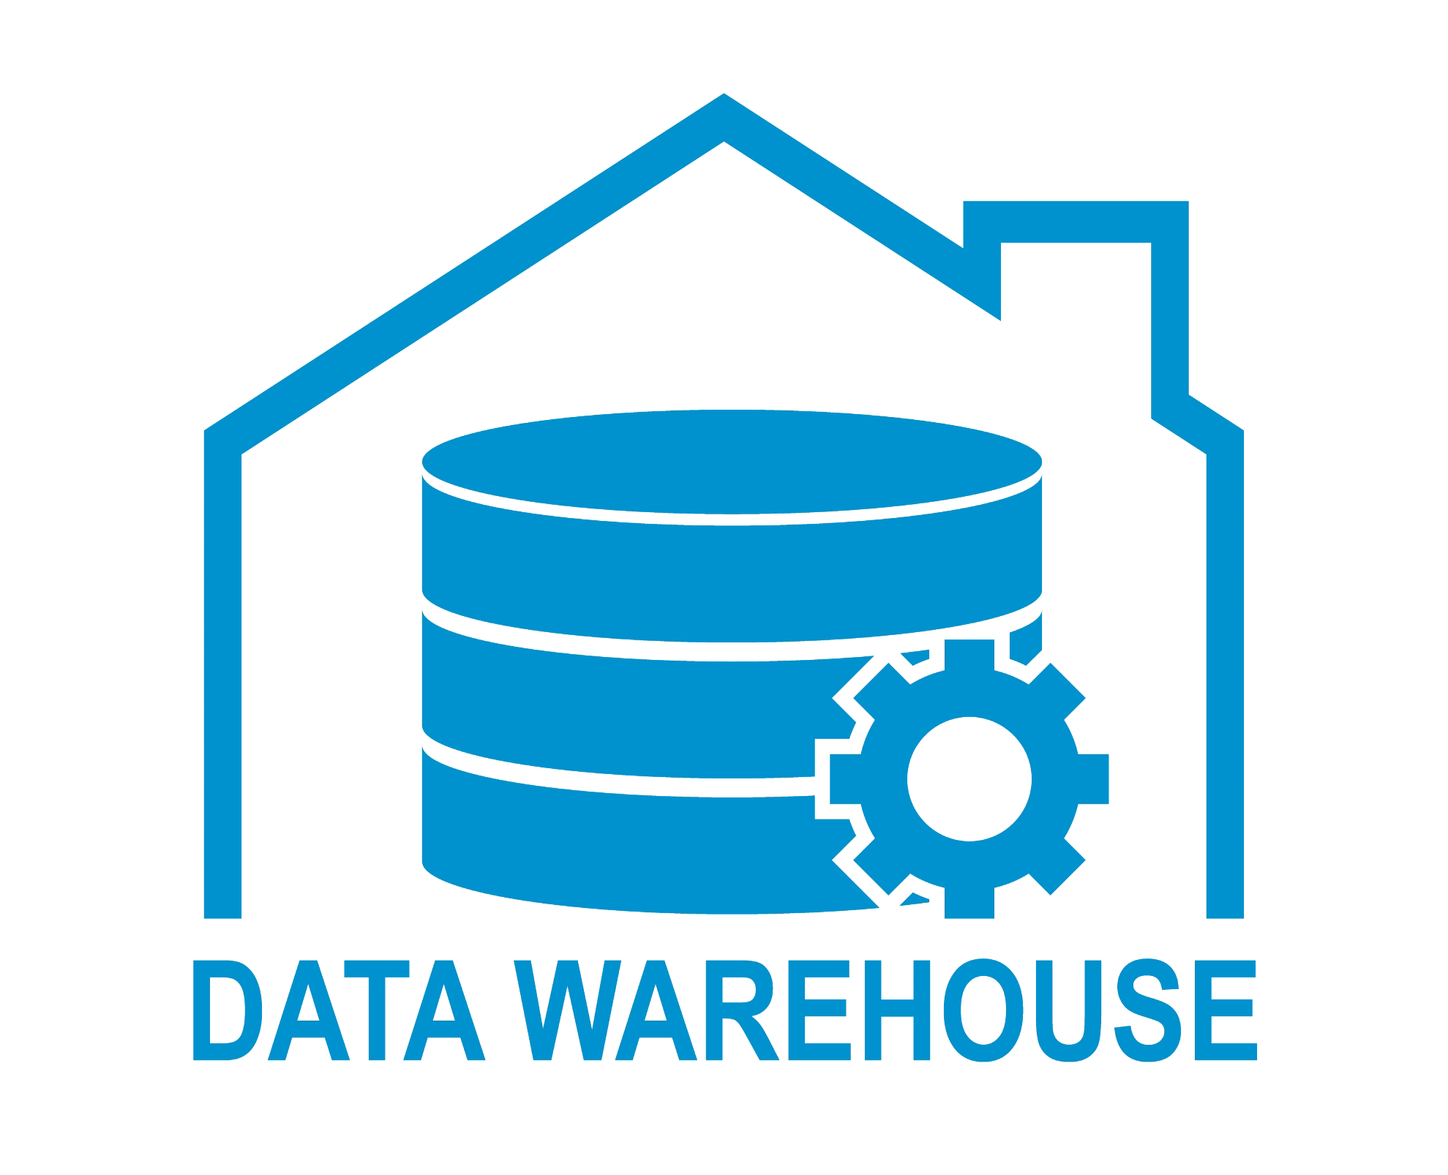
What is Data Warehouse (DWH) ?
A Data Warehousing (DW) is process for collecting and managing data from varied sources to provide meaningful business insights. A Data warehouse is typically used to connect and analyze business data from heterogeneous sources. The data warehouse is the core of the BI system which is built for data analysis and reporting.
It is a blend of technologies and components which aids the strategic use of data. It is electronic storage of a large amount of information by a business which is designed for query and analysis instead of transaction processing. It is a process of transforming data into information and making it available to users in a timely manner to make a difference.

Slide 12



1 Day
Layer 3
1 Day
1 Day
Fast Hours & Automation
Integrated & History
Data Warehouse
Layer 2
ETL
Layer 1

Slide 13
Separation Of Concerns (SOC)
Without SOC
Module A
Module B
Module C
With SOC

Slide 14
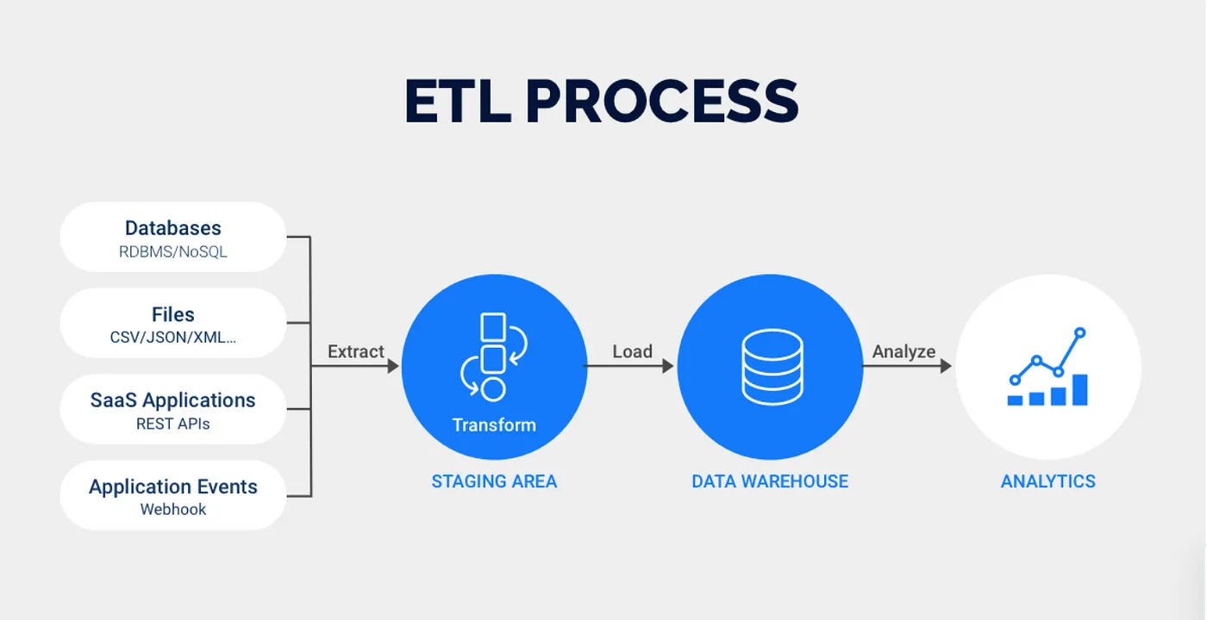
Extract Transform Load (ETL)
The ETL process plays an important role in enabling you to transform raw data from various sources into a clean and usable format for analysis. This involves extracting data from diverse platforms, transforming it, and loading it into a centralized repository. While implementing and maintaining ETL processes can present challenges, the benefits are significant.

Slide 15
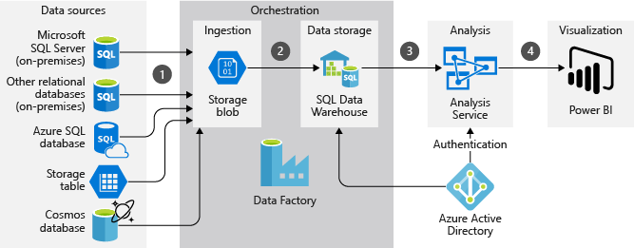
Data Architecture
EL
ETL
TL
L
T
Source
Layer 1
Layer 2
Layer 3
Layer 4

Slide 16
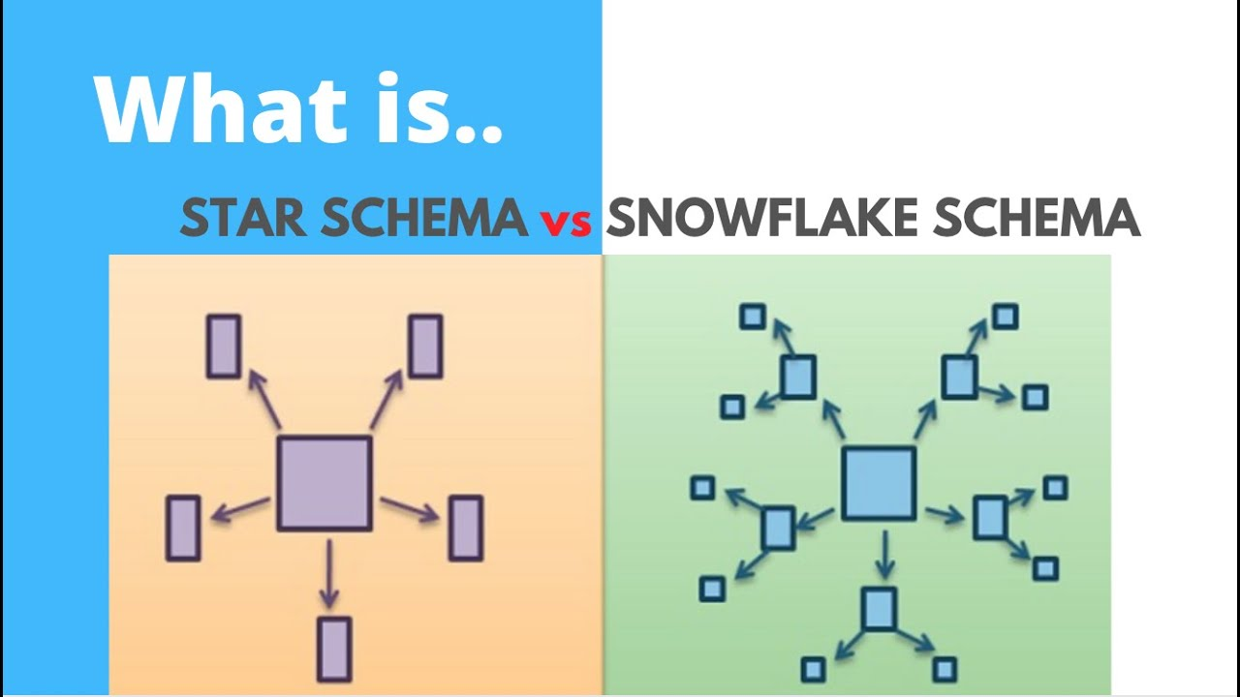
Data Modelling
Data modeling in SQL refers to the process of designing the structure and relationships of a database system. It involves creating a blueprint or a conceptual representation of how the data will be organized and stored in the database. In simpler terms, its creating a data model for data to be stored in.

Slide 17
Star schema and snowflake schema are two common data warehouse designs. The star schema is simpler, with a central fact table connected to dimension tables, resulting in faster queries but potentially more data redundancy. The snowflake schema is more normalized, with dimension tables further broken down into sub-dimensions, reducing redundancy but potentially increasing query complexity.
Key Differences Summarized:
Feature | Star Schema | Snowflake Schema
Structure | Denormalized (single-level dimensions) | Normalized (multi-level dimensions)
Data Redundancy | Higher | Lower
Query Performance | Generally faster | Potentially slower
Complexity | Simpler to understand and implement | More complex to design and maintain

Slide 18
Data Integration
Data integration refers to the process of combining data from multiple sources into a unified, coherent format that can be used for various analytical, operational, and decision-making purposes. This process is essential in today's digital landscape, where organizations gather data from a wide range of sources, including databases, apps, spreadsheets, cloud services, APIs, and more.
Customers
Source A
Customers
Join
Customers
Source B

Slide 19


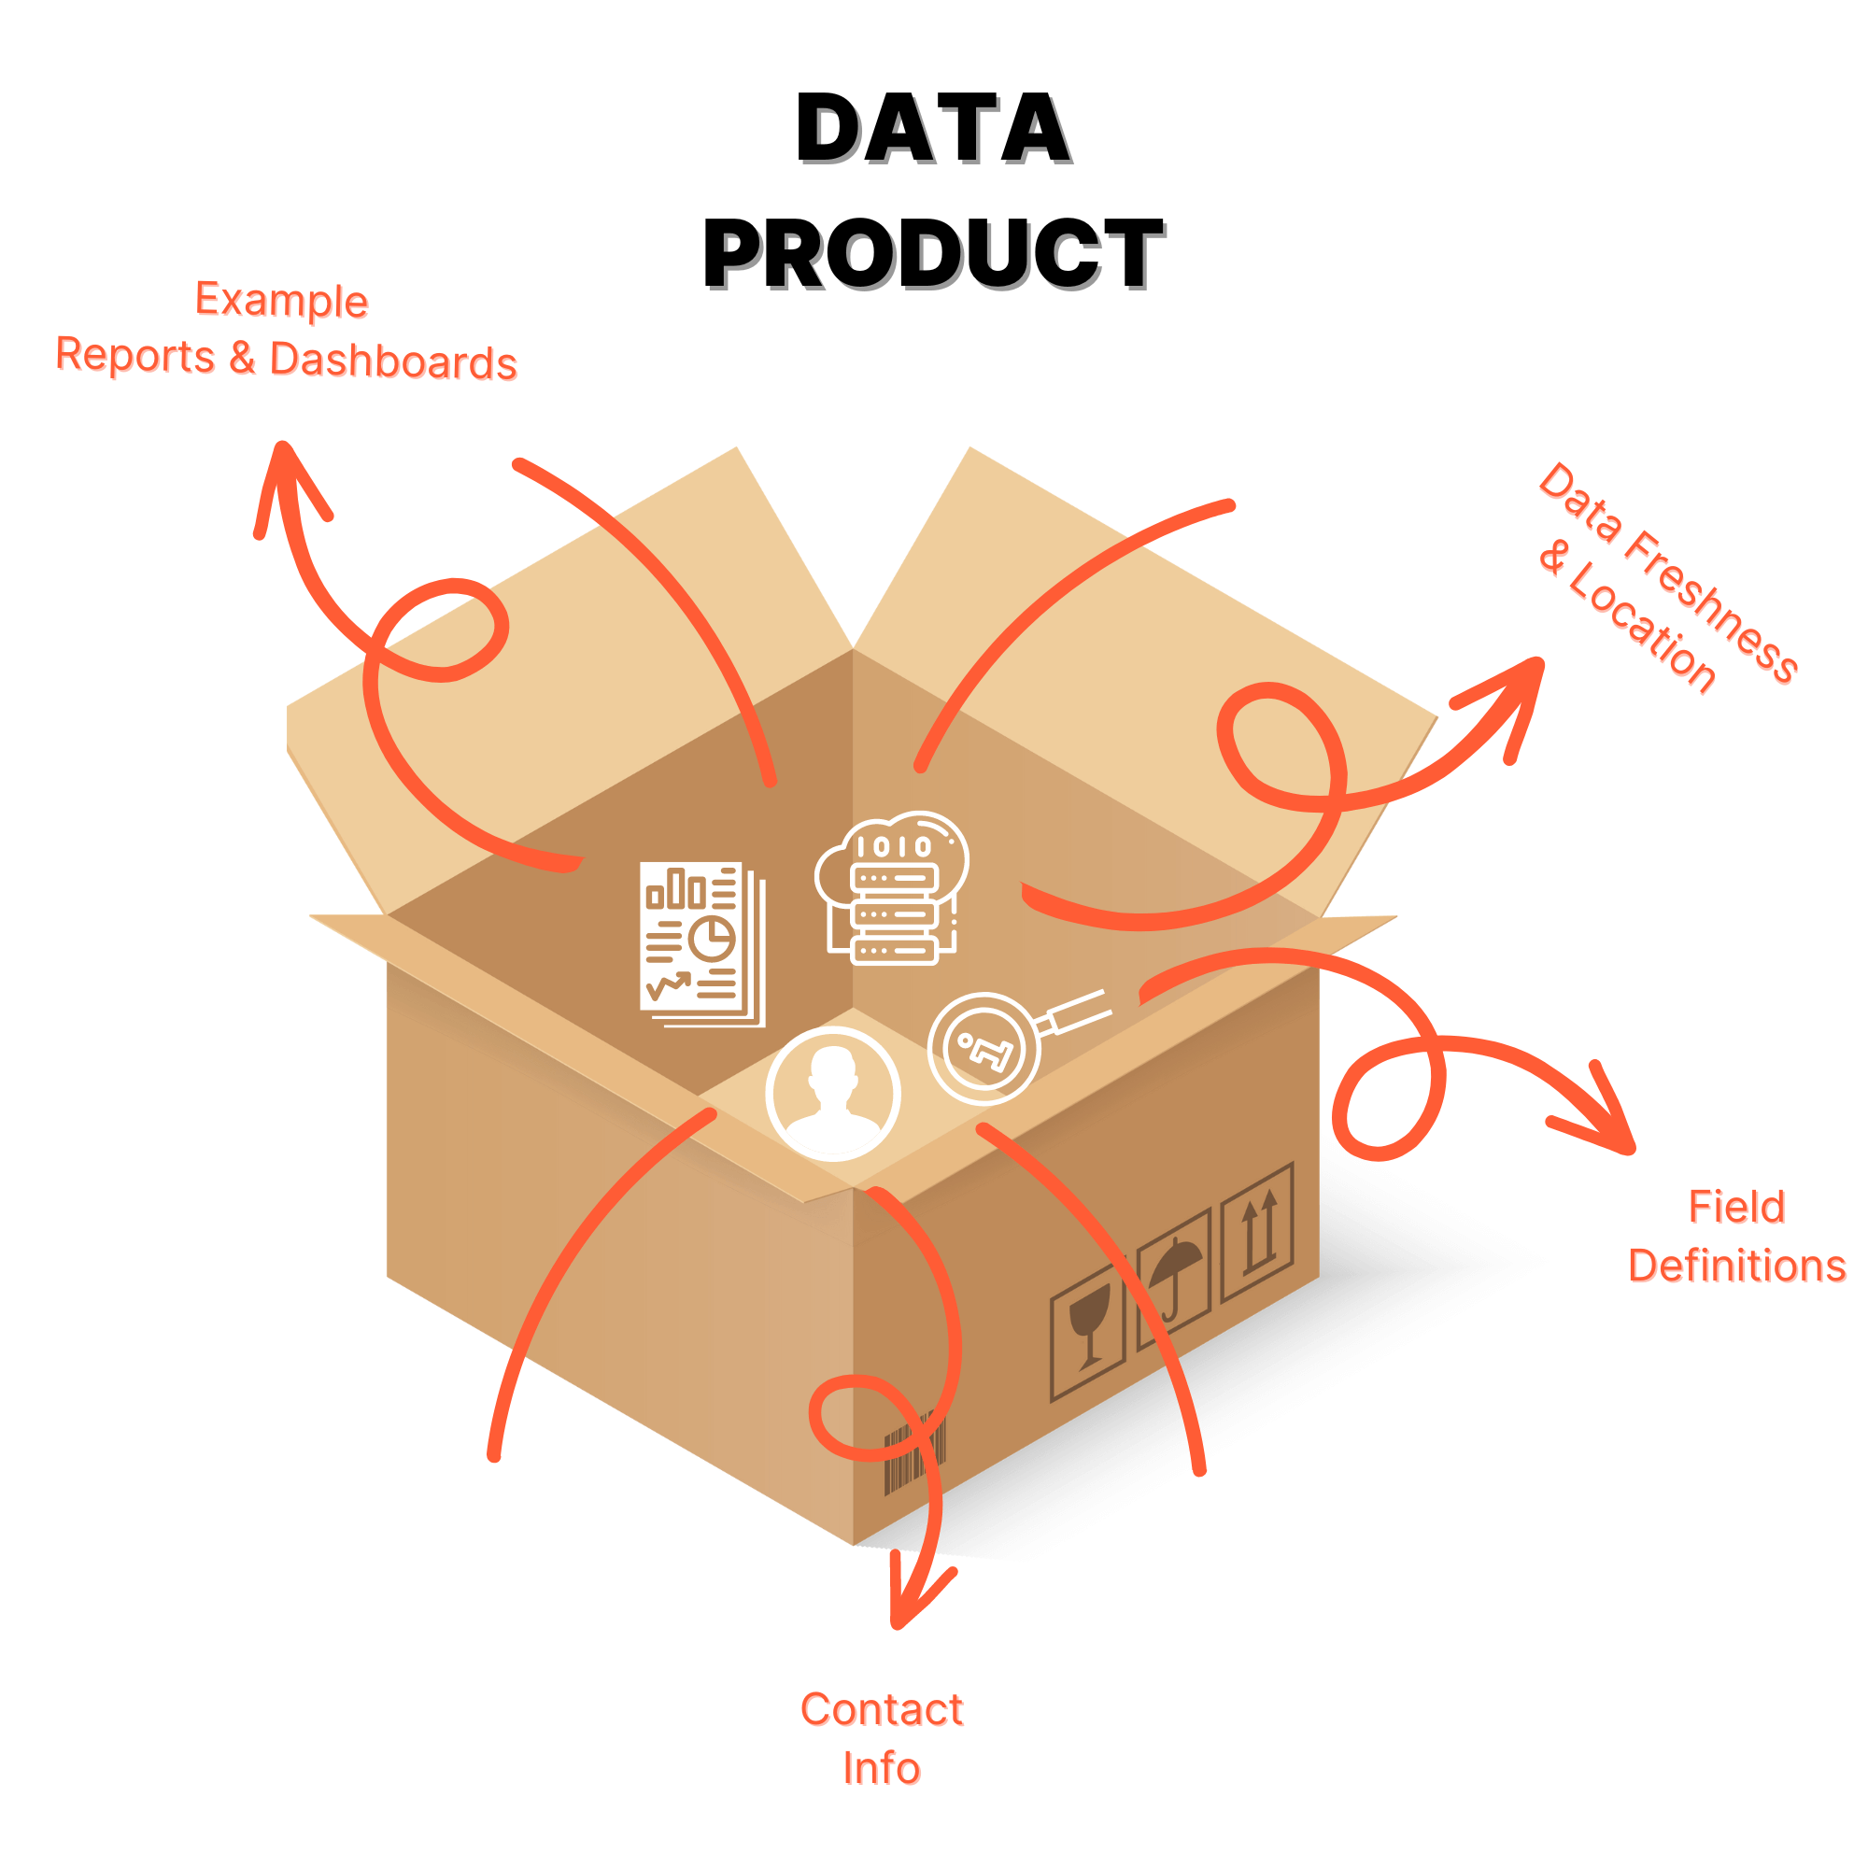




Data Catalog
Data Engineer
Data Catalog
Data Analysts

Slide 20
Data Catalog for Gold Layer
Overview
The Gold Layer is the business-level data representation, structured to support analytical and reporting use cases. It consists of dimension tables and fact tables for specific business metrics.
1. gold.dim_customers- Stores customer details enriched with demographic and geographic data.
Column Name | Data Type | Description
customer_key | INT | Surrogate key uniquely identifying each customer record in the dimension table.
customer_id | INT | Unique numerical identifier assigned to each customer.
customer_number | NVARCHAR(50) | Alphanumeric identifier representing the customer, used for tracking and referencing.
first_name | NVARCHAR(50) | The customer's first name, as recorded in the system.
last_name | NVARCHAR(50) | The customer's last name or family name.
country | NVARCHAR(50) | The country of residence for the customer (e.g., 'Australia').
marital_status | NVARCHAR(50) | The marital status of the customer (e.g., 'Married', 'Single').
gender | NVARCHAR(50) | The gender of the customer (e.g., 'Male', 'Female', 'n/a').
birthdate | DATE | The date of birth of the customer, formatted as YYYY-MM-DD (e.g., 1971-10-06).
create_date | DATE | The date and time when the customer record was created in the system
2. gold.dim_products- Provides information about the products and their attributes.
Column Name | Data Type | Description
product_key | INT | Surrogate key uniquely identifying each product record in the product dimension table.
product_id | INT | A unique identifier assigned to the product for internal tracking and referencing.
product_number | NVARCHAR(50) | A structured alphanumeric code representing the product, often used for categorization or inventory.
product_name | NVARCHAR(50) | Descriptive name of the product, including key details such as type, color, and size.
category_id | NVARCHAR(50) | A unique identifier for the product's category, linking to its high-level classification.
category | NVARCHAR(50) | The broader classification of the product (e.g., Bikes, Components) to group related items.
subcategory | NVARCHAR(50) | A more detailed classification of the product within the category, such as product type.
maintenance_required | NVARCHAR(50) | Indicates whether the product requires maintenance (e.g., 'Yes', 'No').
cost | INT | The cost or base price of the product, measured in monetary units.
product_line | NVARCHAR(50) | The specific product line or series to which the product belongs (e.g., Road, Mountain).
start_date | DATE | The date when the product became available for sale or use, stored in

Slide 21
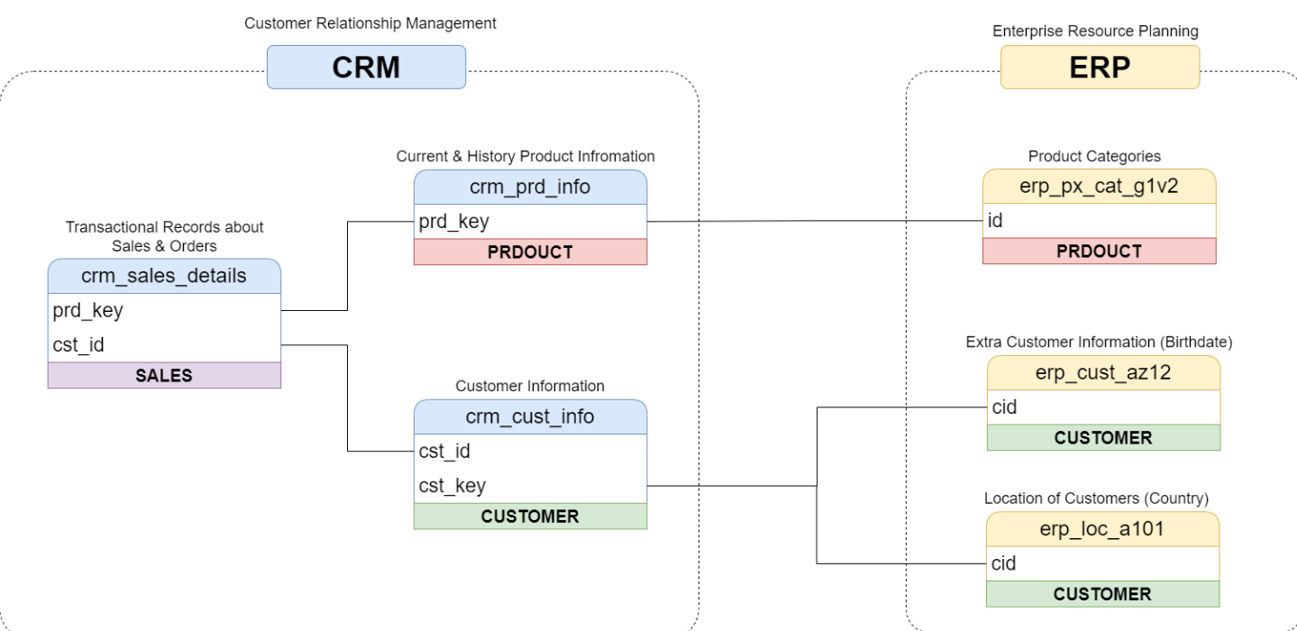
3. gold.fact_sales- Stores transactional sales data for analytical purposes.
Column Name | Data Type | Description
order_number | NVARCHAR(50) | A unique alphanumeric identifier for each sales order (e.g., 'SO54496').
product_key | INT | Surrogate key linking the order to the product dimension table.
customer_key | INT | Surrogate key linking the order to the customer dimension table.
order_date | DATE | The date when the order was placed.
shipping_date | DATE | The date when the order was shipped to the customer.
due_date | DATE | The date when the order payment was due.
sales_amount | INT | The total monetary value of the sale for the line item, in whole currency units (e.g., 25).
quantity | INT | The number of units of the product ordered for the line item (e.g., 1).
price | INT | The price per unit of the product for the line item, in whole currency units (e.g., 25).
Data Integration (How tables are related ?)

Slide 22
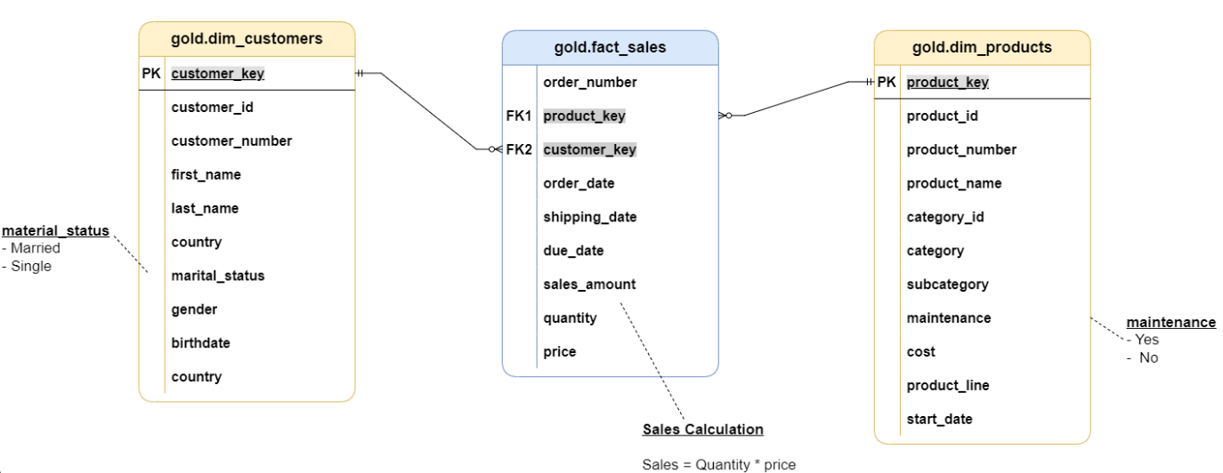
Sales Data Mart (Star Schema)

Slide 23
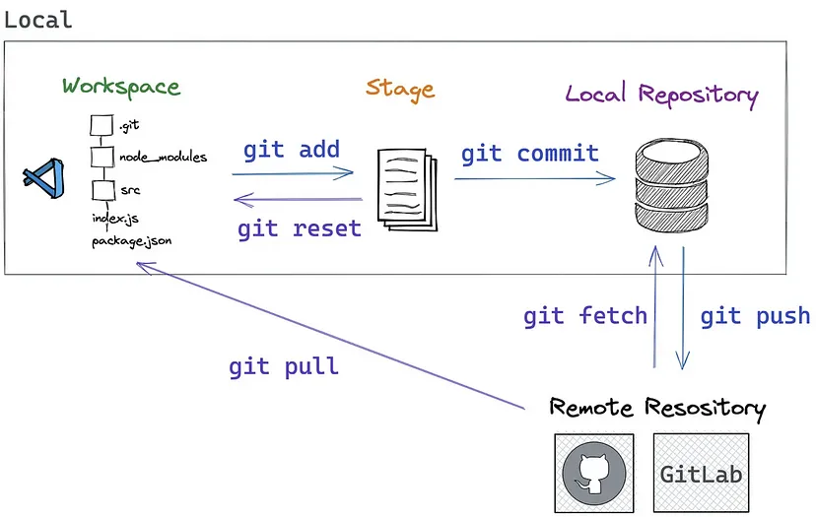
Github Repository

Slide 24
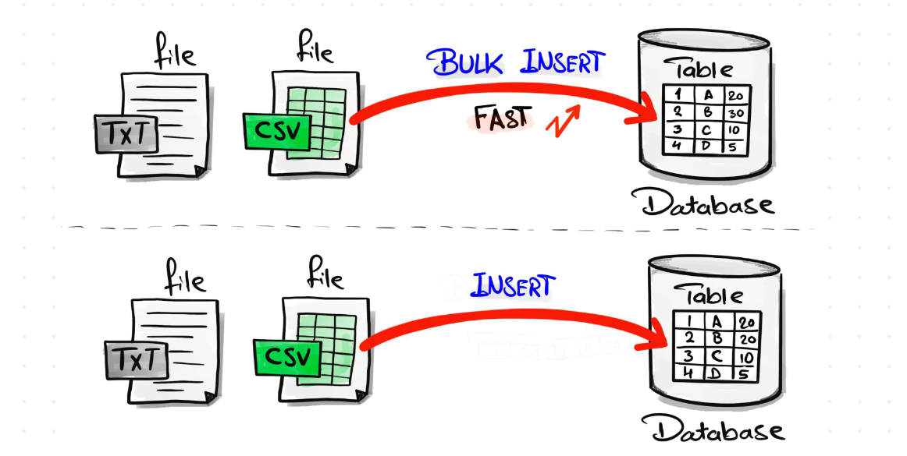
Bulk Insert VS Normal Insert

Slide 25
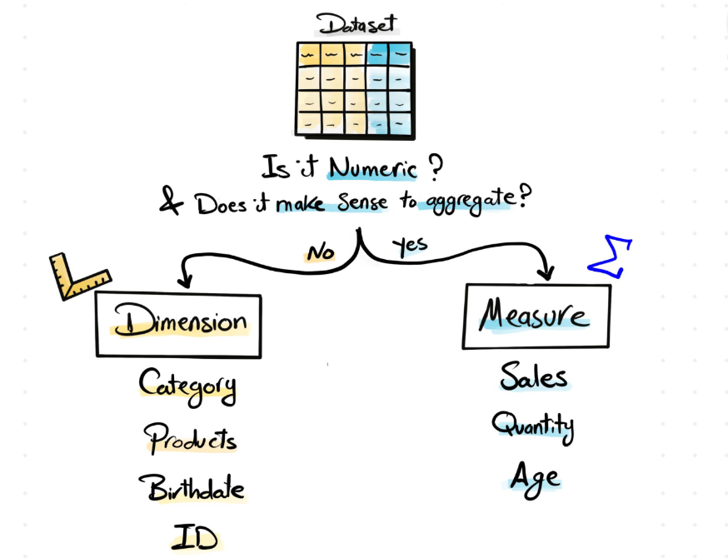
SQL Data Analytics
Dimensions Vs Measures

Slide 26
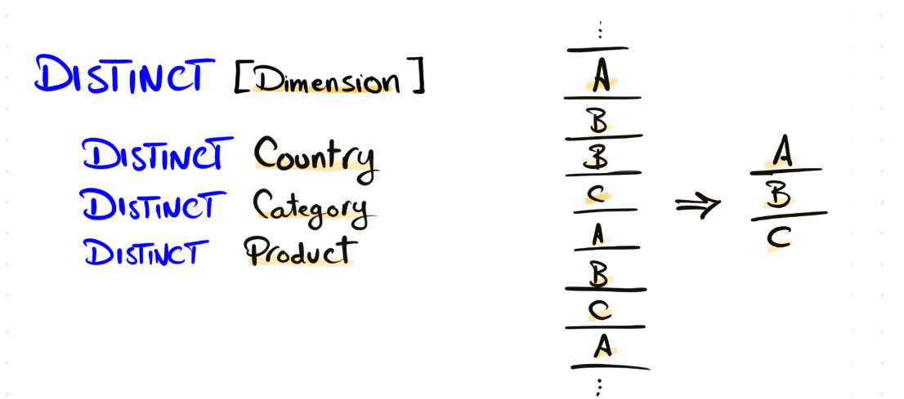
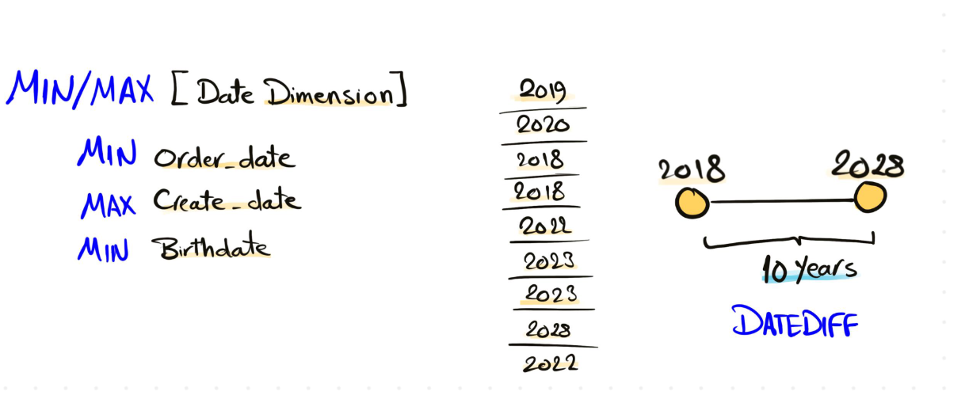
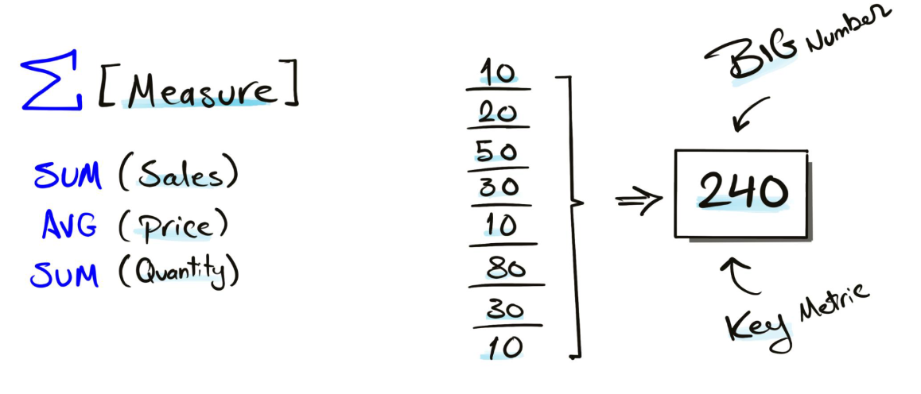
Dimensions Exploration
Date Exploration
Measures Exploration

Slide 27
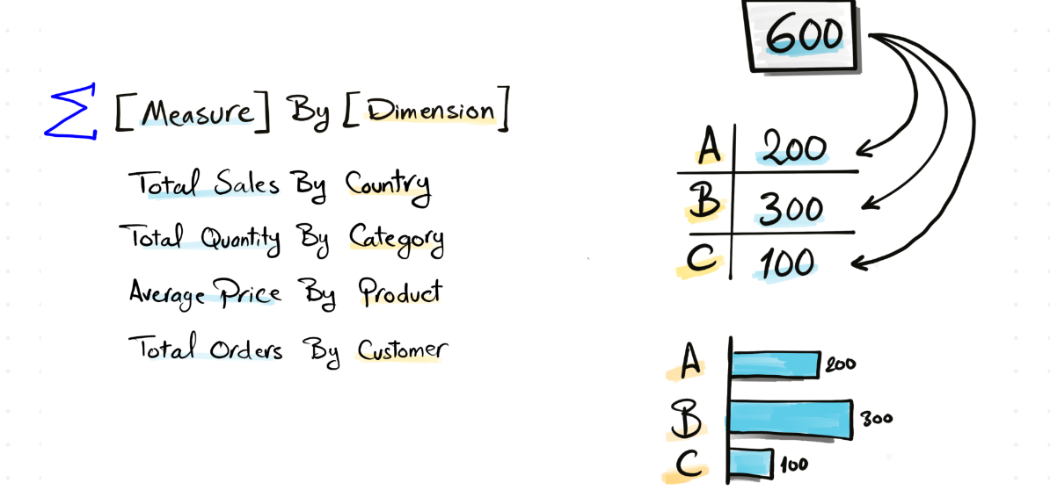
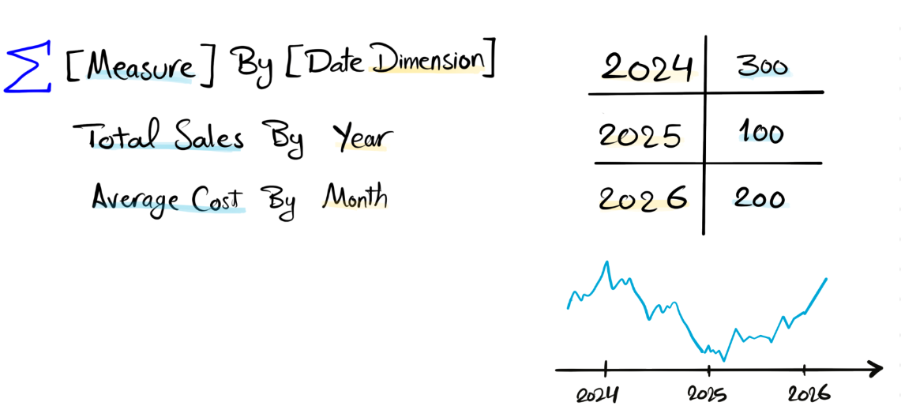
Magnitude
Change Over Time

Slide 28

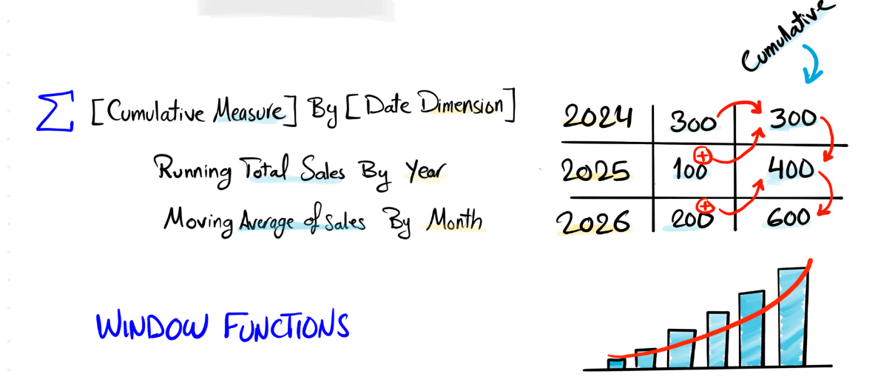
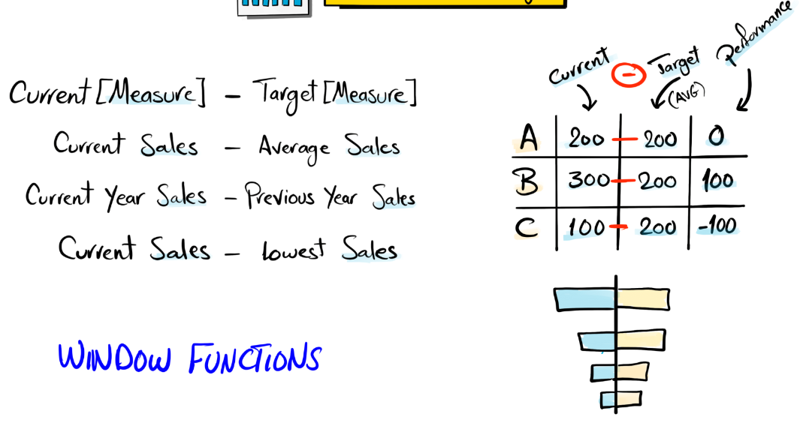
Cumlative Analysis
Performance Analysis

Slide 29
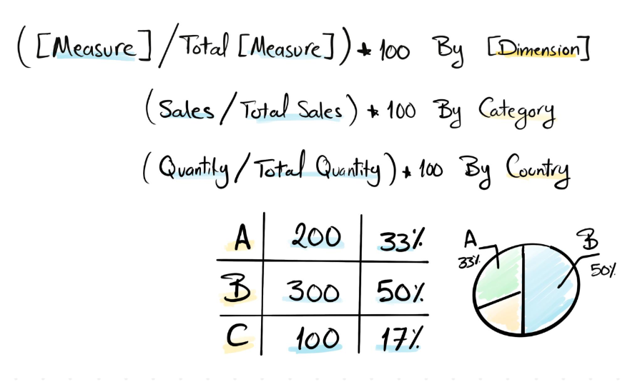
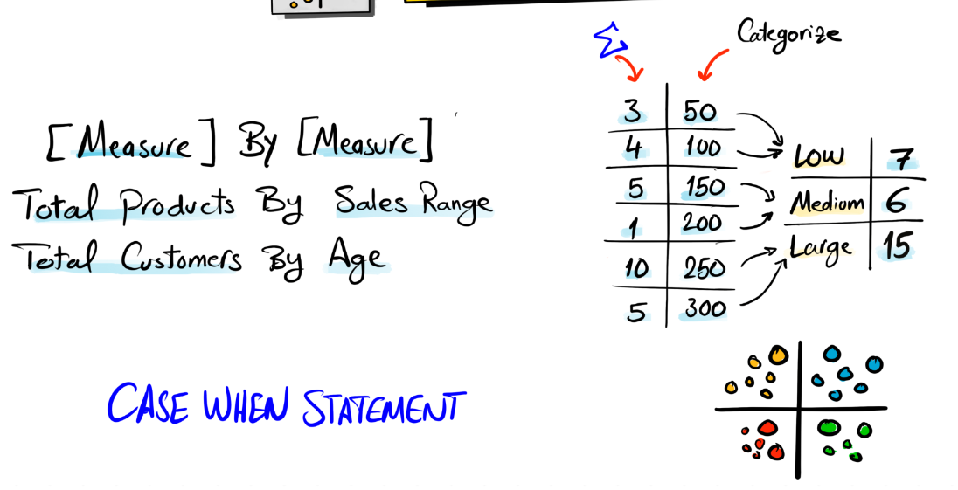
Part to Whole (Proportional Analysis)
Data Segmentation

